Slide 1


NAME: Wairiuko Samuel
COURSE: Data Science Project.
TITLE: Bank Customer Churn
DATE: May 30, 2020

Slide 2
INTRODUCTION

Slide 3
PROBLEM STATEMENT

Slide 4
PROPERTIES OF THE DATASET

Slide 5
CONCEPTUAL FRAMEWORK

Slide 6
OBJECTIVES

Slide 7
HYPOTHESIS GENERATION

Slide 8
DATA PREPROCESSING AND EXPLORATION

Slide 9
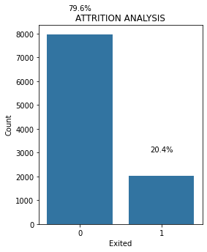
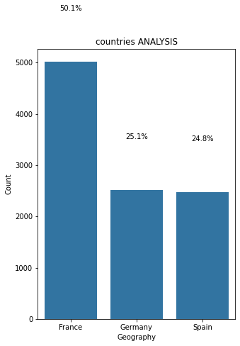
DATA EXPLORATION ANALYSIS (UNIVARIATE/BIVARIATE)

Slide 10
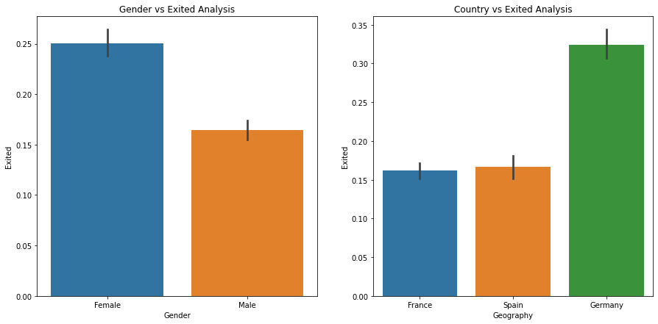
DATA EXPLORATION ANALYSIS (BIVARIATE)

Slide 11
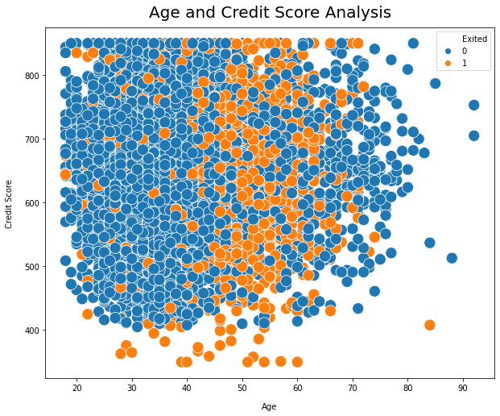
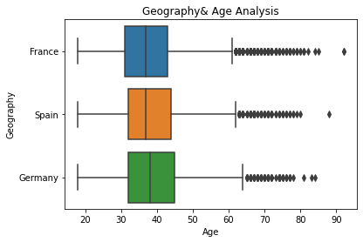
DATA EXPLORATION ANALYSIS (BIVARIATE)
The average age was 40yrs in all the three countries, the oldest customer was 91 years old.

Slide 12
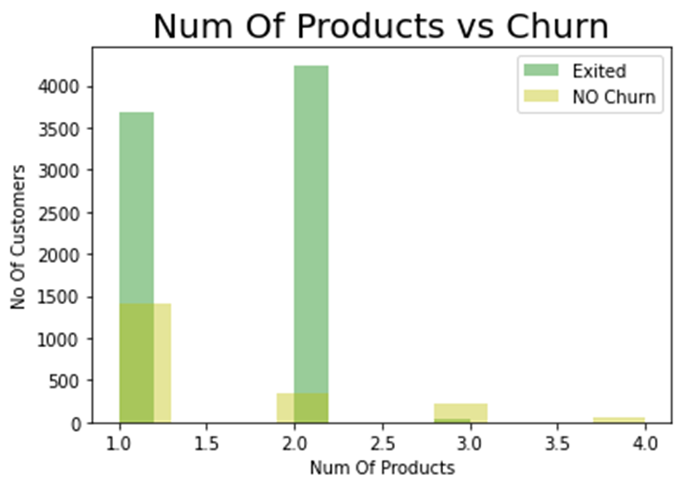
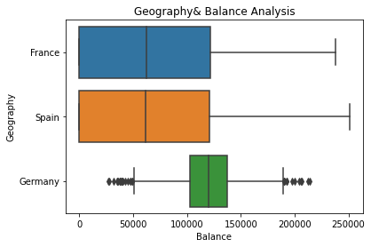
DATA EXPLORATION ANALYSIS (UNIVARIATE/BIVARIATE)

Slide 13
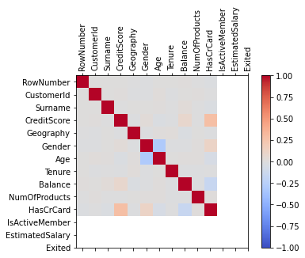
DATA EXPLORATION ANALYSIS (CORRELATION)
Darkest red means high positive correlation while the blue shows negative correlation between the variables

Slide 14
FEATURE ENGINEERING
I used One-Hot-Coding to creating dummy variables for geographical variable that has 3 categories – ‘France, ‘Germany’ and ‘Spain’. One hot coding removed this variable and generated 3 new dummy variables 0 and 1 using ‘get dummies’ function of Pandas. I also used Label Encoding to convert Gender column which had Male and Female column to Gender encoded with dummy variables of 0 and 1

Slide 15
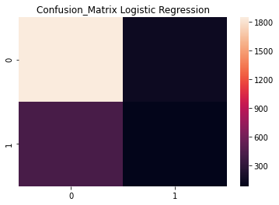
MACHINE LEARNING MODEL RESULTS (LOGISTIC REGRESSION)
Accuracy of Logistic regression classifier on training set:79.03%.
Accuracy of Logistic regression classifier on test:78.68%.
True positive(accuracy),False positive(precision),True negative(recall),F1 score(Combination of precision and recall)

Slide 16
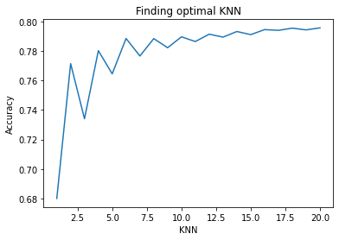
MACHINE LEARNING MODEL RESULTS (KNN)
Accuracy of KNN classifier on training set:90.85%.
Accuracy of KNN classifier on test:87.12%.
True positive(accuracy),False positive(precision),True negative(recall),F1 score(Combination of precision and recall)

Slide 17
MACHINE LEARNING MODEL RESULTS(RANDOM FOREST)
Accuracy of Random Forest classifier on training set:90.85%.
Accuracy of Random Forest classifier on test:87.12%.
True positive(accuracy),False positive(precision),True negative(recall),F1 score(Combination of precision and recall)

Slide 18
MACHINE LEARNING MODEL SUMMARY RESULTS
 | Model | Training Accuracy % | Testing Accuracy %
0 | Logistic Regression | 80.94 | 80.68
1 | K-nearest neighbors | 87.02 | 82.88
2 | Random Forest Classifier | 100.00 | 86.88
3 | Support Vector Machine | 86.82 | 86.28
4 | Decision Tree Classifier | 100.00 | 79.88
 | Model | Training Accuracy % | Testing Accuracy %
0 | Tuned Logistic Regression | 79.02 | 78.68
1 | Tuned K-nearest neighbors | 81.66 | 76.24
2 | Tuned Support Vector Machine | 100.00 | 79.64
3 | Tuned Decision Tree Classifier | 81.13 | 81.52
4 | Tuned Random Forest Classifier | 90.85 | 87.12
Tuned Random Forest Classifier was the best model for prediction with training accuracy of 90.85% and test accuracy of 87.12% followed by Tuned Decision Tree Classifier with training accuracy of 81.13 and test accuracy of 81.52% in predicting whether the customer exited or not. The difference between Tuned support vector train results and test results was 20% therefore not a good model .

Slide 19
SUMMARY FINDINGS AND CONCLUSION

Slide 20
RECCOMENDATIONS

Slide 21
THANKYOU
30TH MAY 2020

